Slide 1
Sahm and Michez Rule Applied to Multiple Countries
Natalie Parker Blount
University of California Santa Cruz December 2025
Available At:

Slide 2
Question Review
Question: If adjusted for different labor markets, are the Sahm and Michez Rules still effective for predicting recessions? If so, how effective?
Professor Michaillat and Professor Saez refine the Sahm Rule into the Michez Rule for predicting recessions using the unemployment and vacancy rates, finding it effective in the US
The Economist put out a research paper/study on the Sahm Rule (unadjusted) and it’s ineffectiveness at predicting recessions in other countries
The paper did not make any adjustment to the Rule, so there are two outcomes:
Even when Adjusted, the Sahm Rule is not effective at predicting recessions in other countries
When Adjusted, the Michez Rule is effective at predicting recessions in other countries

Slide 3
Positioning
(Pascal Michaillat 1 | Emmanuel Saez 2 2025)
Outlines the basis for my paper by setting up the mathematical equations for using the three month trailing average of vacancy rates and unemployment rates with thresholds to predict recessions. Creating the Michez Rule
(David G. Blanchflower And Alex Bryson 2022)
Applies the Sahm Rule with adjustments to OECD countries
rule for predicting recession using the fear of unemployment series to predict recession. Rule shows a 10-point rise in the series compared to its previous 12 month low predicted the onset of the Great Recession in both the United States and Europe.
(The Economist 2024)
Argues that the Michez and Sahm Rules are not effective at predicting recessions in other countries

Slide 4
Methodology Review
Combined Unemployment and Vacancy rate data, recession data, and applied the Michez and Sahm Rules
Graphed them all to see what thresholds need to be adjusted and if the new thresholds still work or if the equations would need redoing to be accurate
Then Adjusted the Thresholds to make the predictions still accurate
Sahm: the 3-month avg of unemployment minus its 12-month low
Michez: the decline in the 3-month avg of the vacancy rate relative to its 12-month high. (Higher unemployment + lower vacancies) Take the minimum of the two indicators (i.e., the weaker of the two) to define the Michez indicator. This ensures the signal only triggers when both unemployment is rising and vacancies falling (simultaneous stress in labor market).

Slide 5
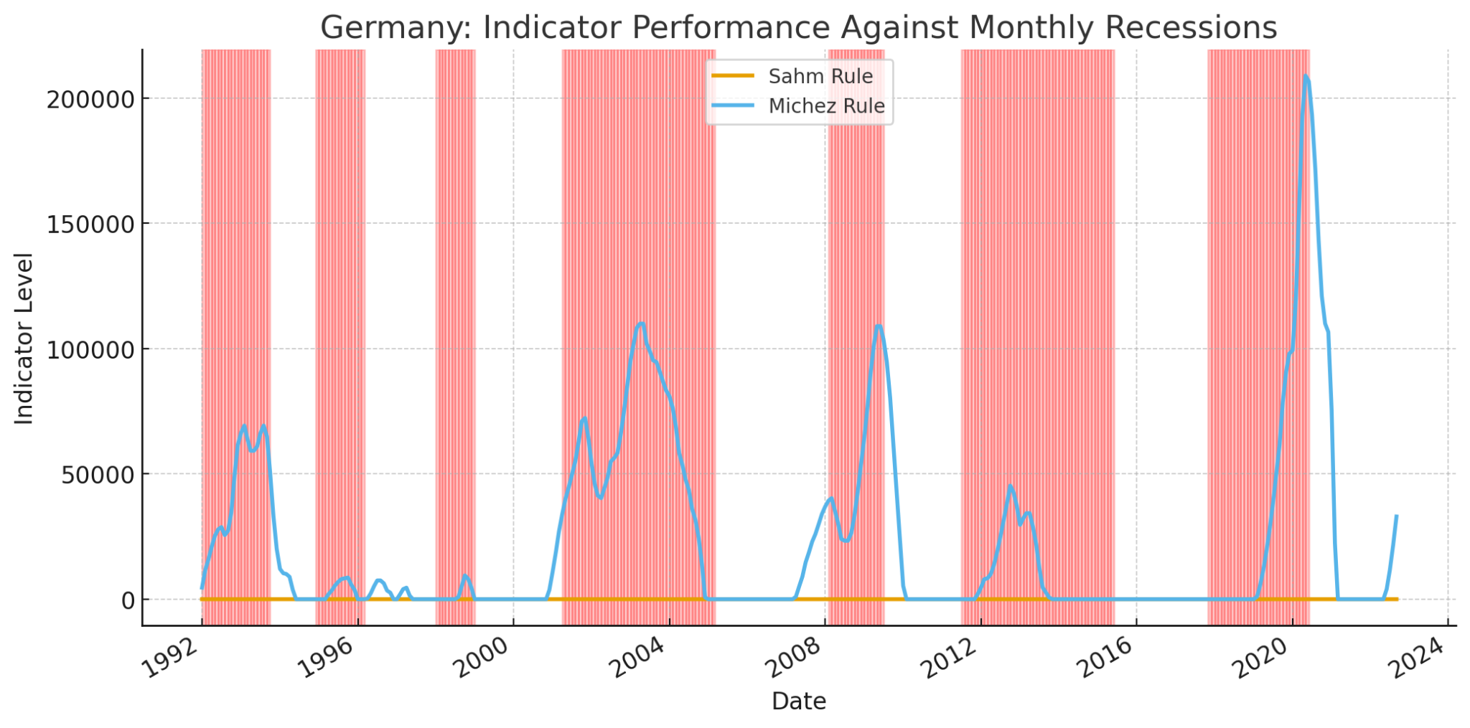
Figures and Graphs: Graph 1(Germany)

Slide 6
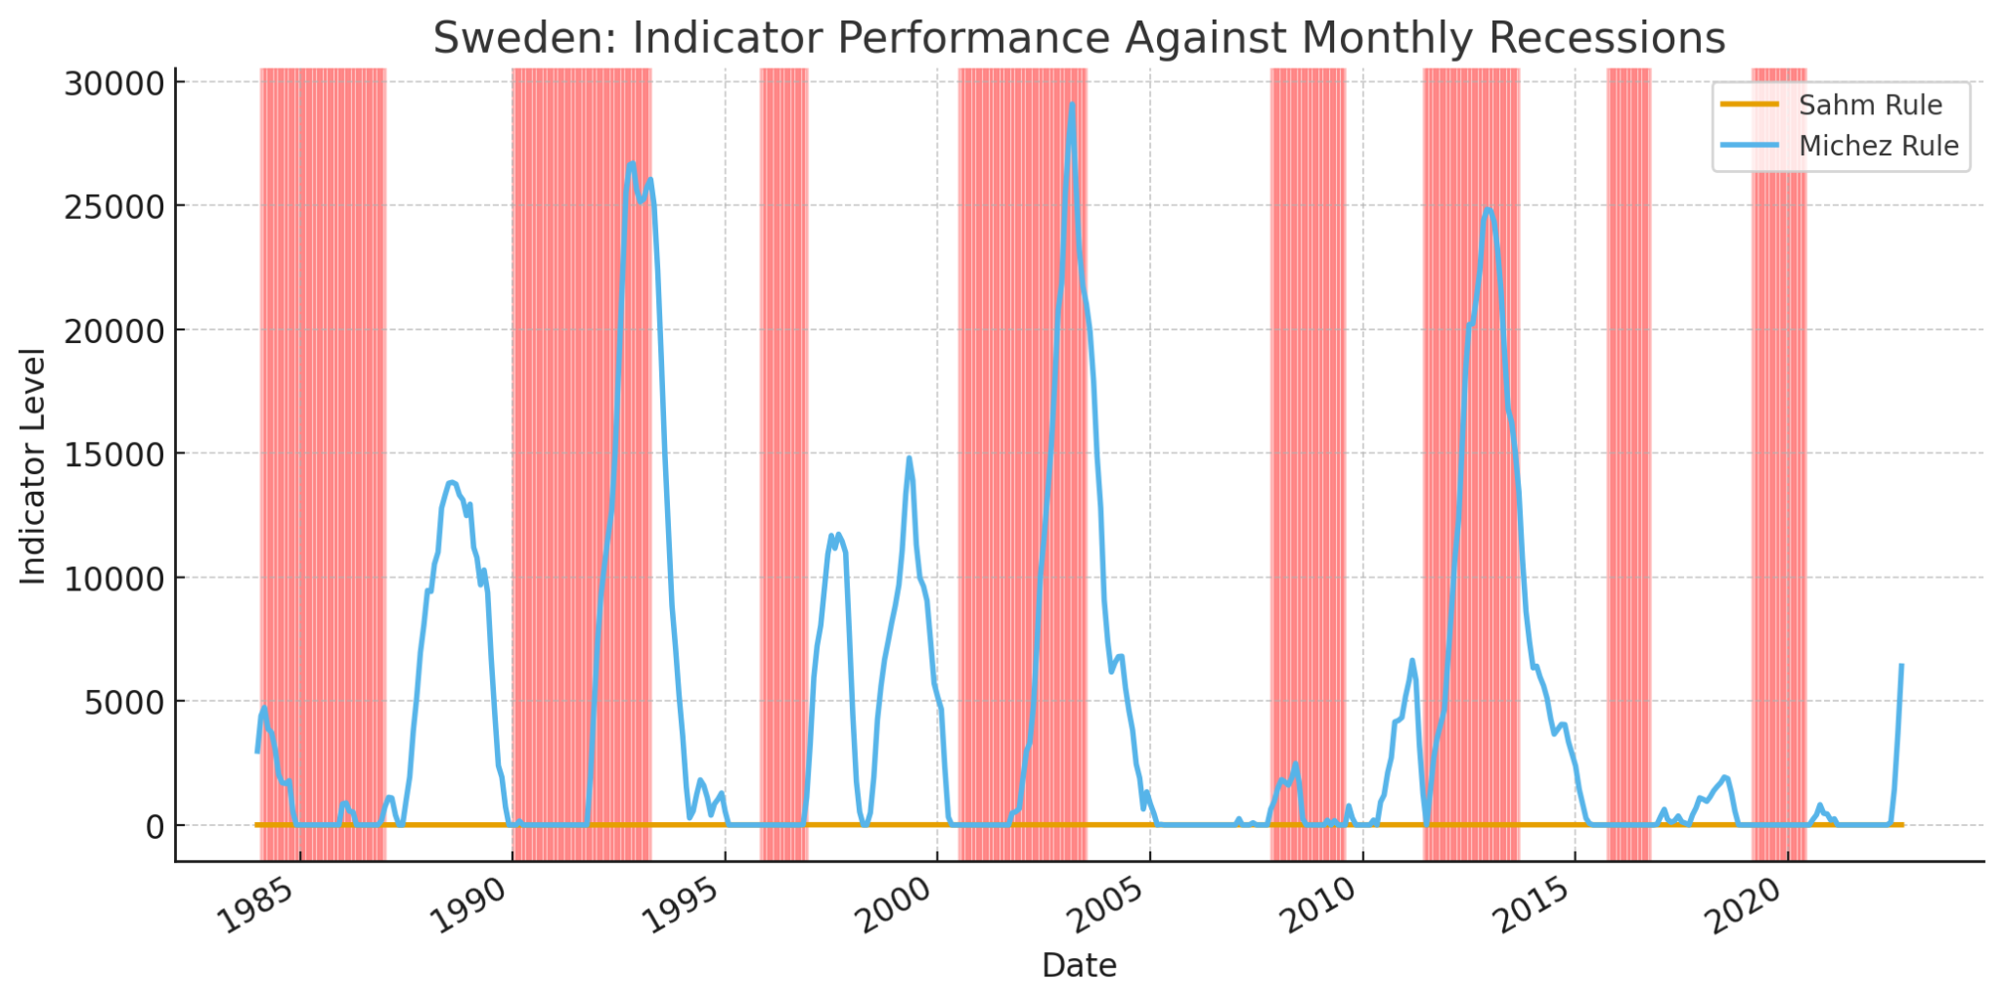
Figures and Graphs: Graph 2 (Sweden)

Slide 7
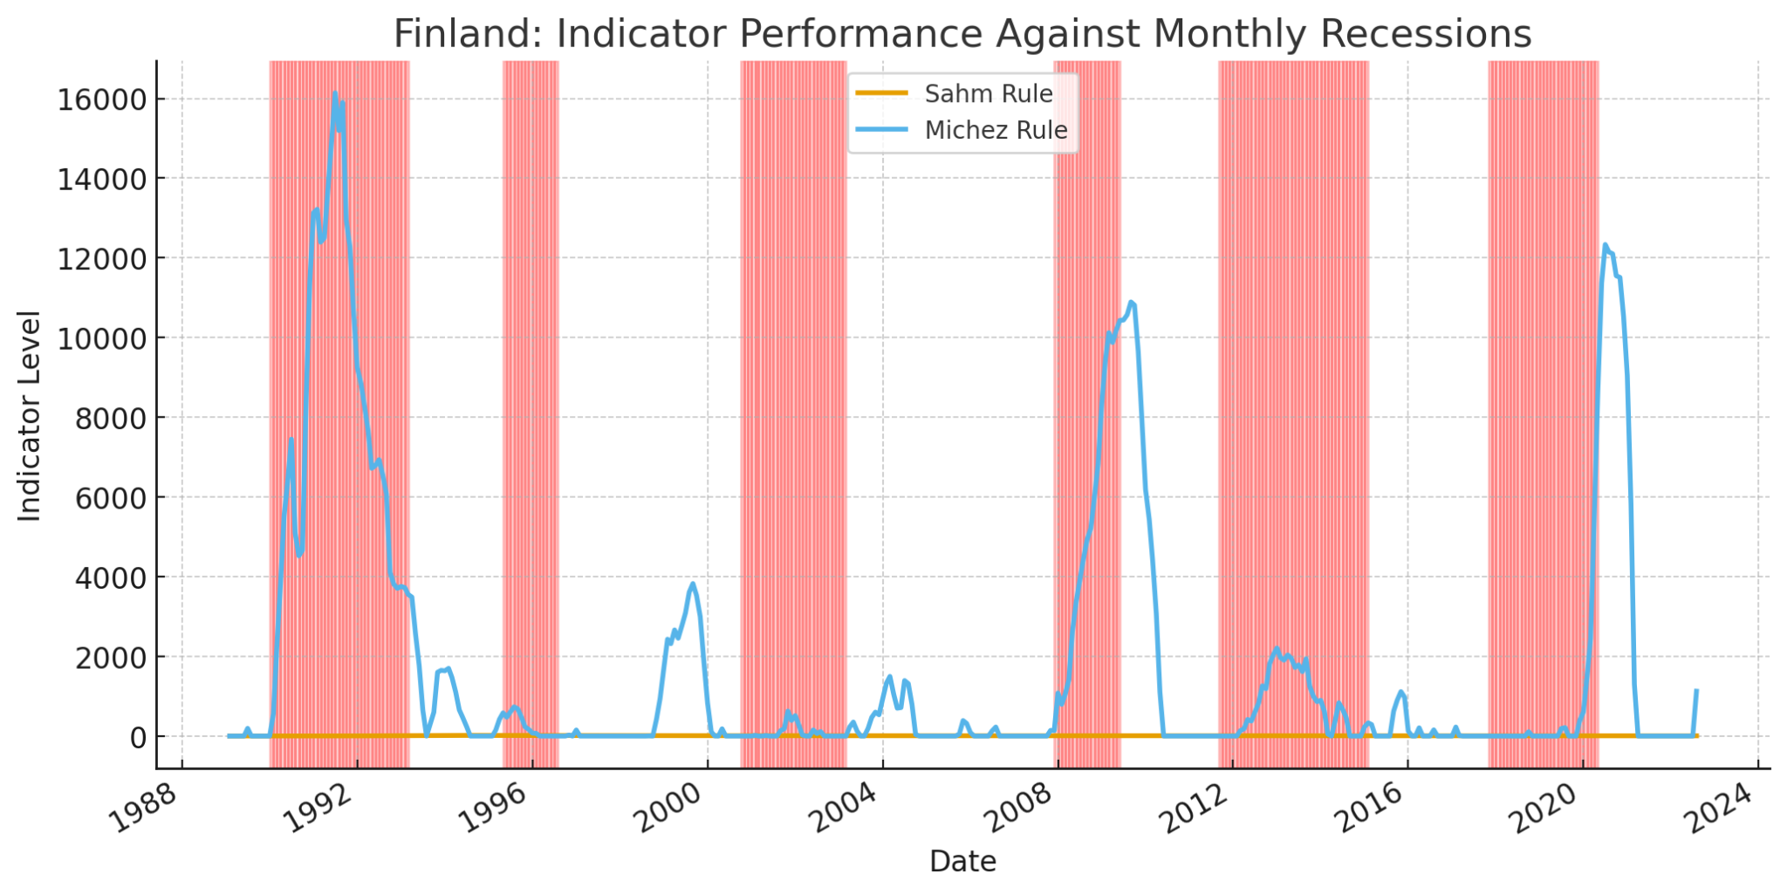
Figures and Graphs: Graph 3 (Finland)

Slide 8
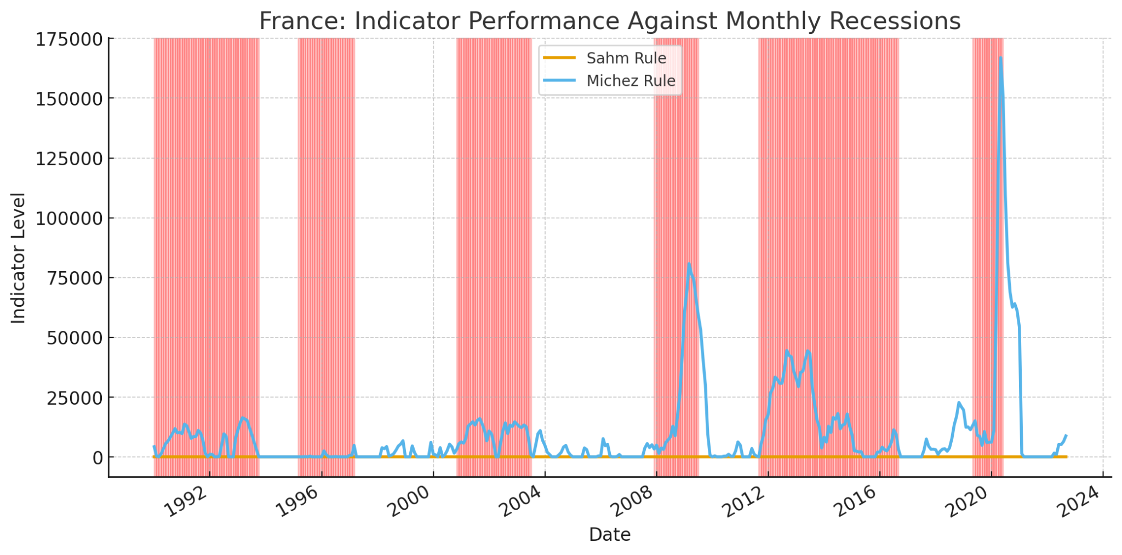
Figures and Graphs: Graph 4 (France)

Slide 9
Graph
Red sections are where the recession value indicator is 1, meaning that the country is in a recession. These are points of confirmed recession in these countries.
The orange line is the Sahm Rule which typically rests at zero unless the unemployment three month average moves 0.55 percentage points above the 12 month minimum. This is because unemployment rarely jumps sharply.
The blue line is the Michez rule that measures decline in job vacancies. We can see that in all four countries, the Michez rule is far more responsive, and there are large spikes in the indicator. This means a job vacancy collapse and per the graphs, we can see that these visibly lead recessions. This includes being accurate more quickly than the Sahm Rule usually indicating recession several months before the recession begins. For each country however, looking at the graphs you can see that they have different levels of volatility and reaction to Vacancy changes. Finland and Sweden have higher volatility showing that it takes much smaller spikes in the indicator to indicate recession as compared to France and Germany

Slide 10
Inconsistency in Results
Could not find downloadable data for vacancy rates so some of them are based on total job vacancies and some on new vacancies measure in persons not in percentages (France and Sweden based on new vacancies) (Germany and Finland Based on total job vacancies)
Could not find data for total labor force participation by people to do it myself
Used the same indicator base for recessions indications
Different countries had different years of data and did not always have large time blocks
Difficult to find Monthly Data
Potential User Error (First time doing a project like this)

Slide 11
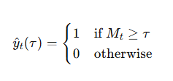
Mathematical Equations and Adjusted Thresholds
After gathering the data and computing the Michez Rule, I used another math equation to find the optimal thresholds for each country based on the data
Compute the Michez Value
Use all of the values to test for the best Threshold treating every value as a potential new threshold Ƭ ∈ {All Michez Values in the Data}
Make the predictions using the recession dummy variable of 1 or 0 to measure how effective the t value is, then evaluate using the F1 score
(how many predictions were correct)*(how many recessions the indicator caught)
F1=
2*
(how many predictions were correct)+(how many recessions the indicator caught)

Slide 12
Conclusion
Each country has different social structures, labor markets, and recession patterns. So it is important to adapt our equations and thresholds to accommodate these unique situations and provide more accurate and faster signaling recession predictors.
Adjusting the thresholds for these countries make them more effective and accurate
In this essay I have come to the conclusion that the Michez Rule is effective for predicting recessions in other countries when adjusted to reflect past patterns of labor markets and recessions

